Slide 1

Customer Segmentation
Nisa Albert, Maitri Bhatt, Charini Jayasekera, Princi Sharma
BITM 603
Business Analytics and Data Mining

Slide 2
Business Problem
Any business goal is to make profits.
Customer satisfaction plays a vast role
Retail e-commerce sector, customer expectations can change dramatically.
This has led to less profits and less demand by the customers for the products.
Identifying customer segments and treat differently for each segment.

Slide 3

Business and Data Mining Goal
Business Goals
“To target the customers based on their purchase pattern, common needs or other attributes to increase the revenue for an ecommerce website by selecting to target a single group or multiple groups through its products and services.”
Data Mining Goals
“To segment this customers through Demographic, Geographic, or Psychographic in distinct clusters and determining the correlation or association among these attributes.”

Slide 4

Data Description
Retrieved dataset from kaggle.com
Include transactions from an online retail organization from year 2010 to 2011
Exploratory Data Analysis and Visualization conducted.
Additional columns were created to further analyze data.

Slide 5
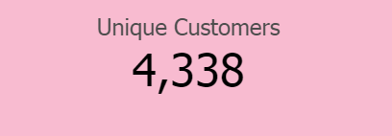
Data Pre-Processing
Determine how many transactions in dataset and the uniqueness of data.
Identify the duplicates and null values from the data.
Identify tag in InvoiceNo; cancelled orders, labeled and remove it.
Identify tags in Stock code; 'POST', 'D', 'C2', 'M', 'BANK CHARGES', 'PADS', 'DOT',etc.
Rename column headers from ‘ï»¿InvoiceNo’: ‘InvoiceNo’.
Create boxplot to identify outliers and remove it.
Create new variables contingent on models or algorithms
Normalize variables as needed for K-means.

Slide 6
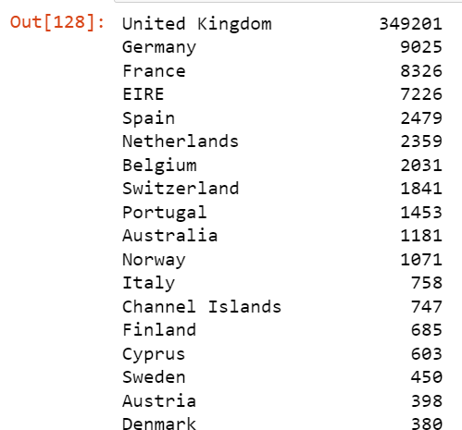
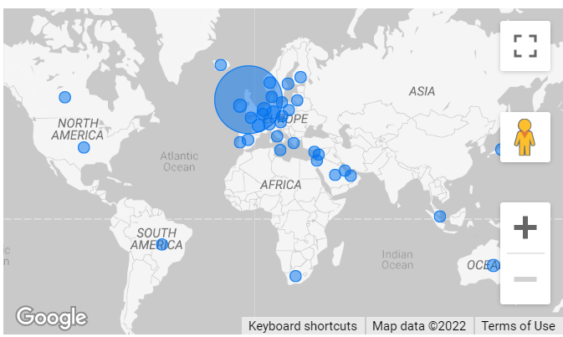
Data Visualization-Country analysis

Slide 7
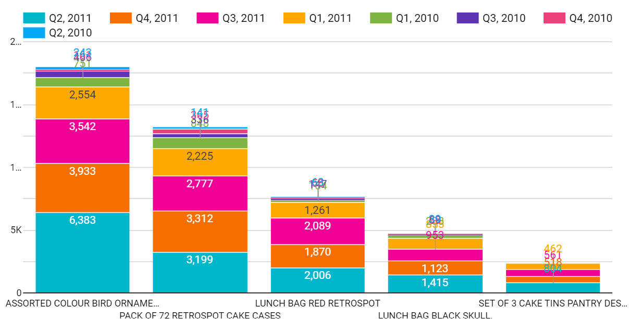
Data Visualization-Product VS Quantity Analysis
Notes:
Bulk orders are generally low with lower frequency and does not contribute majorly on the revenue, implies that we need to target the frequent consumers.

Slide 8

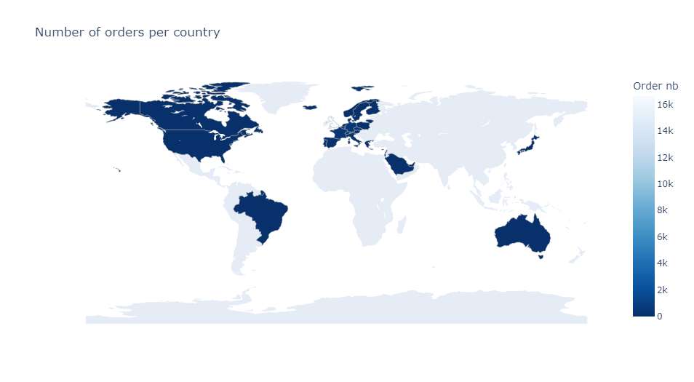
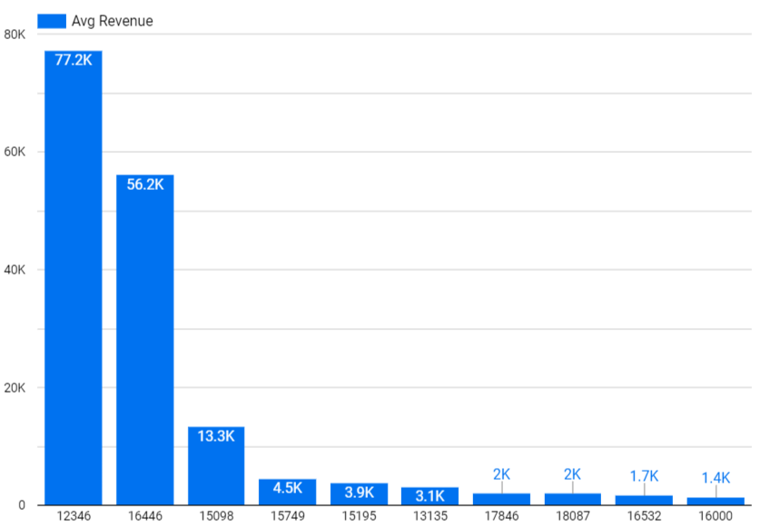


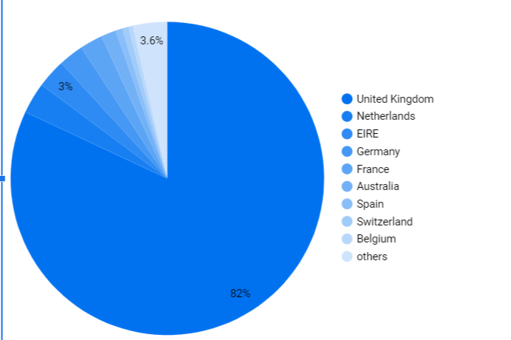
Data Visualization - Customer Based
Country Based Revenue
CustomerID
The top 10 customer’s are UK based, placing bulk orders generating 82% revenue for which 90% are based in UK and second highest revenue contributors are from Netherlands 3.2% .
Notes:
The top 10 customer’s are UK based placing bulk orders generating 82% revenue are 90% based in UK and second highest contributors(quantity wise) are from Germany 2.6%.
5 million
8 Million

Slide 9
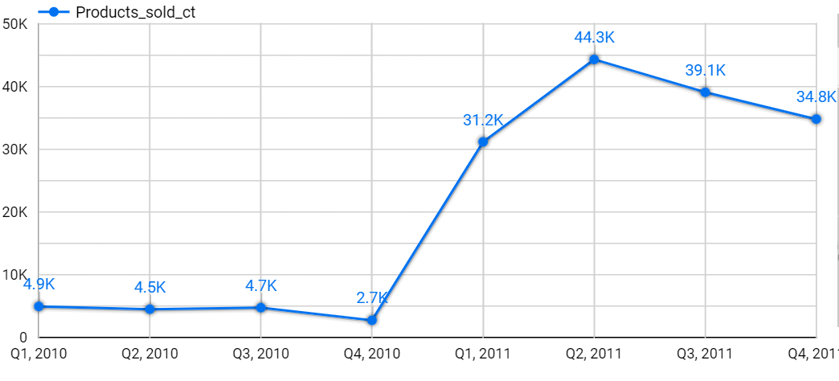
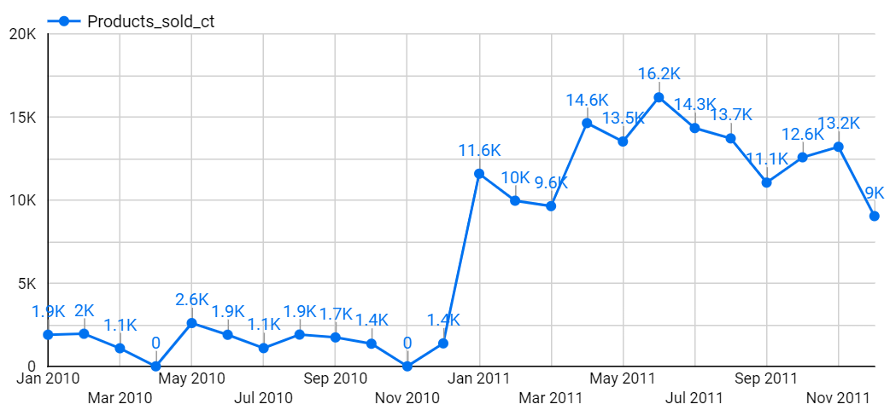
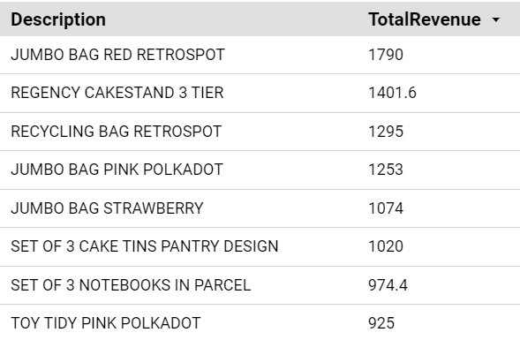
Data Visualization- Monthly Sale Analysis
The yearly comparison shows nearly 10X more sales in 2011 and second quarter of 2011 wherein June being the highest revenue generating month.
Notes:
The yearly comparison can show nearly 10X more sales in 2011 and second quarterly being the highest revenue generating month. June being the most profitable I accumulated the top 8 sellers which show clear resemblance in the category.

Slide 10
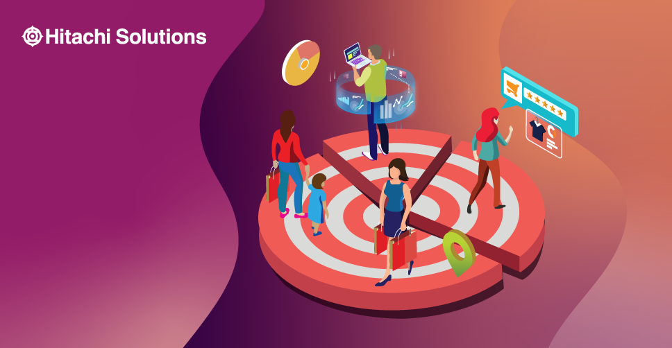
How to use customer segments to grow your business?
Questions to ask
For whom are we creating value?
Who are our most important customers, clients, or users?
We want to create a personalized experience for our customers by creating buyers personas and specific interest. This approach saves time and increases revenue.
Having a unique audience is useful as it highlights the uniqueness of our customer base and increase relevance for our marketing approaches.
Business grows when we know:
Who are our loyal customers
Retracting lapsed customers
Target category buyers
Surveys

Slide 11
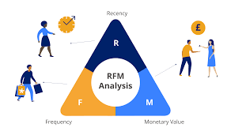
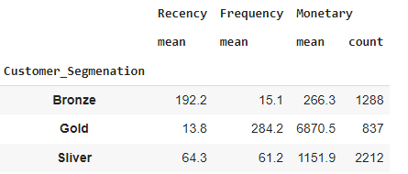
K-Means Clustering
Recency: How recently have they made a purchase?
Frequency: How often have they bought something?
Monetary: How much money do they spend on average when making purchases?
Notes:
K means clustering is one of the most popular clustering algorithms, when solving clustering the idea to group data points into distinct non-overlapping subgroups.

Slide 12
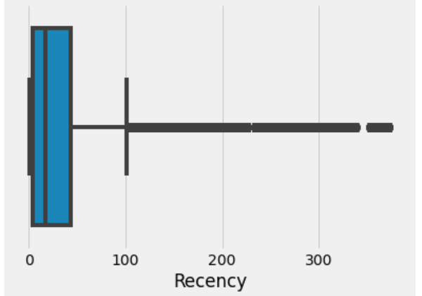
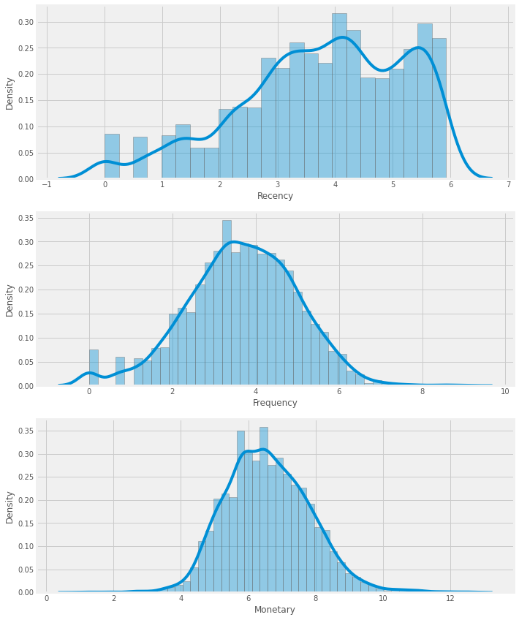
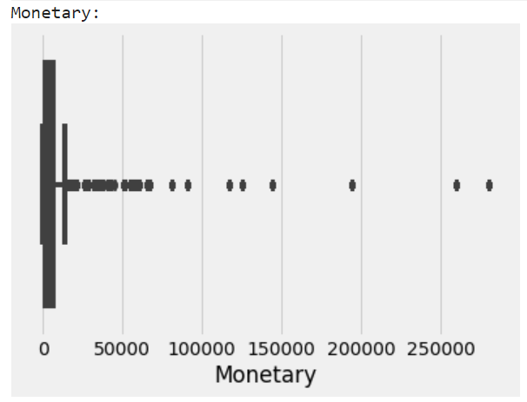
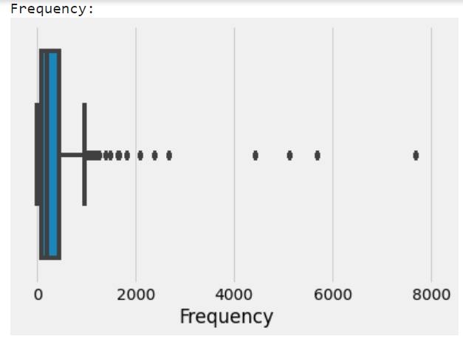
K-Means Clustering

Slide 13
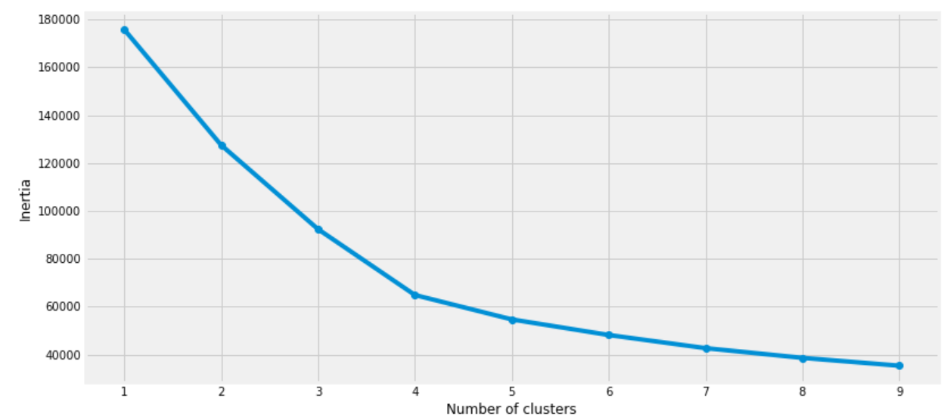
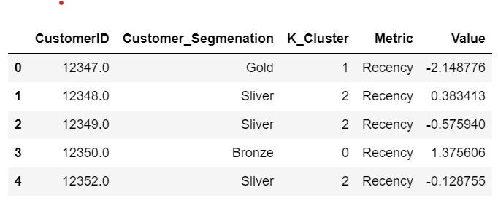
K-Means Clustering

Slide 14
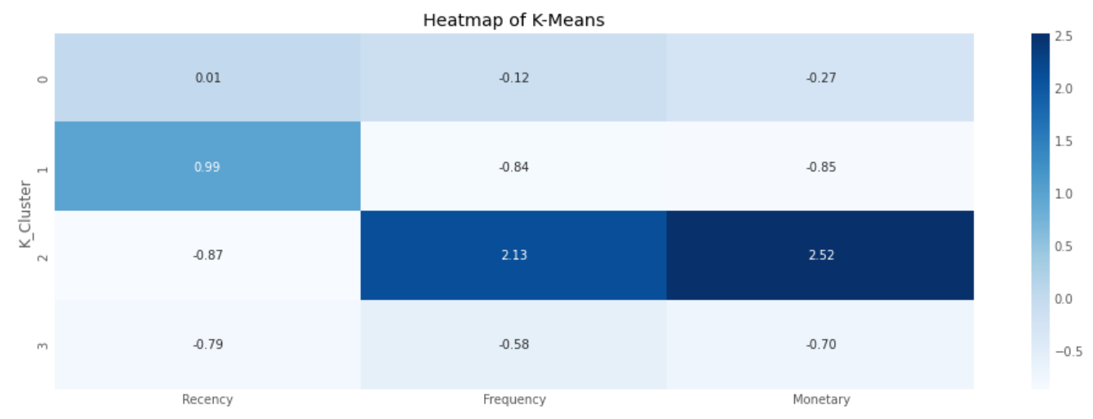
K-Means Clustering

Slide 15
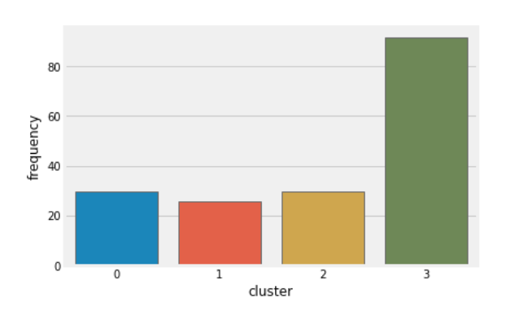
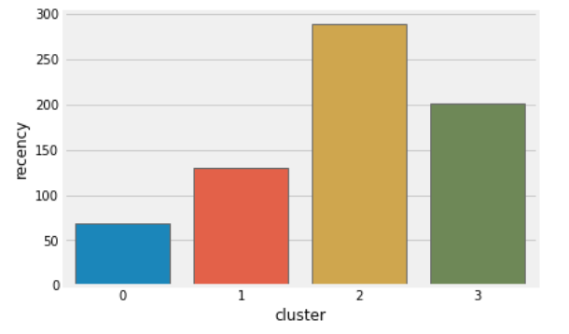
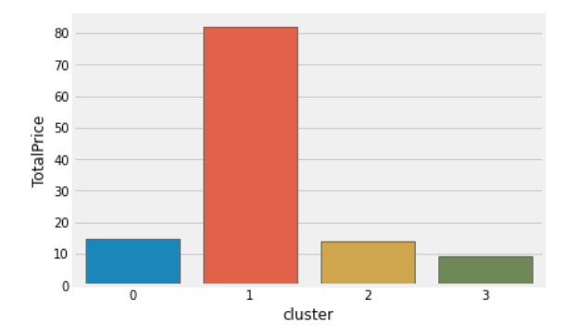
Customer Segmentation Using K-Means

Slide 16
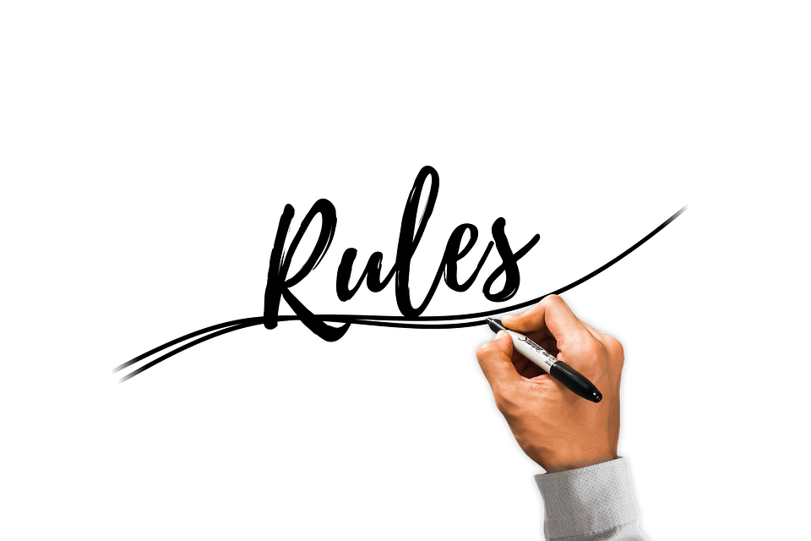
Algorithm-Association Rules
Often used in customer transaction databases to determine what goes with what?
Aid to determine the relationship between items and dependencies.
Analysis conducted on Customer ID and Description
Generate frequent item sets
Metrics used to determine strength of association implied by the rule

Slide 17
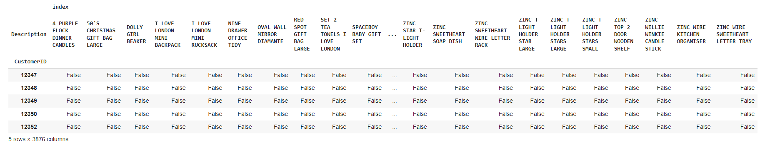
Algorithm-Association Rules
Convert Description and Customer ID into binary incidence matrix format
Rule selection
Frequent Item Sets

Slide 18
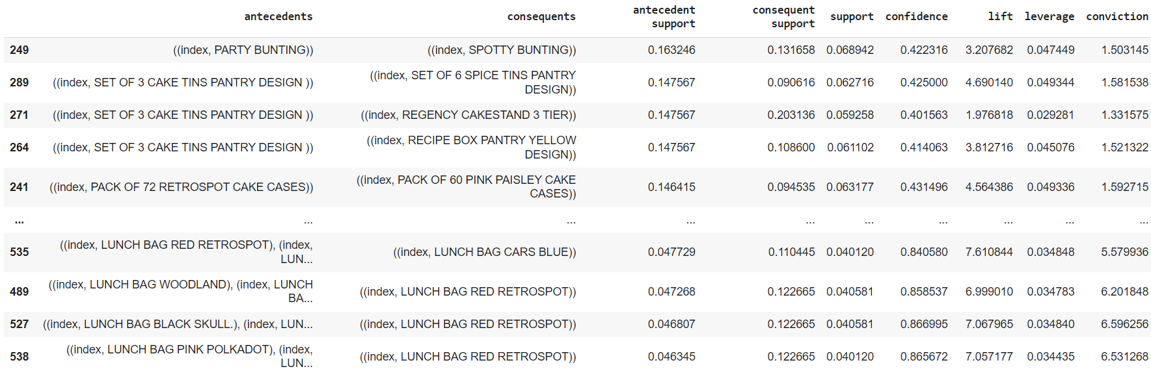
Algorithm-Association Rules-Results
Metrics used to determine strength of association implied by the rule

Slide 19
Recommendations
Treat different customer segments differently to make the best outcome.
Gold | Highest Profitable | Lower subscriptions prices Be customized and offer more
Silver | Average | Reward system/Loyalty points Recommendation system with associated products
Bronze | Lowest Profitable | Buy one get one free method More discounts Send more text messages with special sales and promotions. Free trial periods for the products.

Slide 20
Conclusion and Limitations
The dataset was from 2010-2011, which is only one year of data and we could miss transactions patterns and should ideally review more than 1 year of transactions.
No data regarding customer feedback which helps to explain customer behavior
Less number of variables which consumed time in making additional variables deriving from the original dataset.
Models should run bi-weekly to upkeep the accuracy of the model. When accuracy becomes 75%, the data set should be updated.

